Slide 1
A Very Low Cost Vector Network Analyzer
And Why You Just Might Want One!
John Eisenberg
K6YP
July 16, 2020

Slide 2
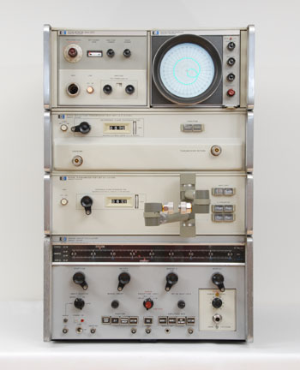
It was 1969, and I was a brand new Microwave
Engineer at Watkins-Johnson in Palo Alto
I was fortunate to have the new HP8410A VNA system on my bench.
It covered 100 MHz – 2 GHZ and 2 GHz – 12.4 GHz in two bands.
It was the very first Vector Network Analyzer system on the market!
It was a tremendous advance in microwave instrumentation.
Its competition was the slotted line and hand calculations.
The HP 8410A system sped up measurements by >50 times.
The VNA displayed swept data on a Smith Chart. Using
it made microwave measurements intuitive! The 8410A
system hooked me on RF and microwave engineering!
Cost was about $12500 which was nearly twice my annual pay.
Present day VNAs cost between $10K and $50k.
In 1969 a ham could not even dream of owning one of these!

Slide 3
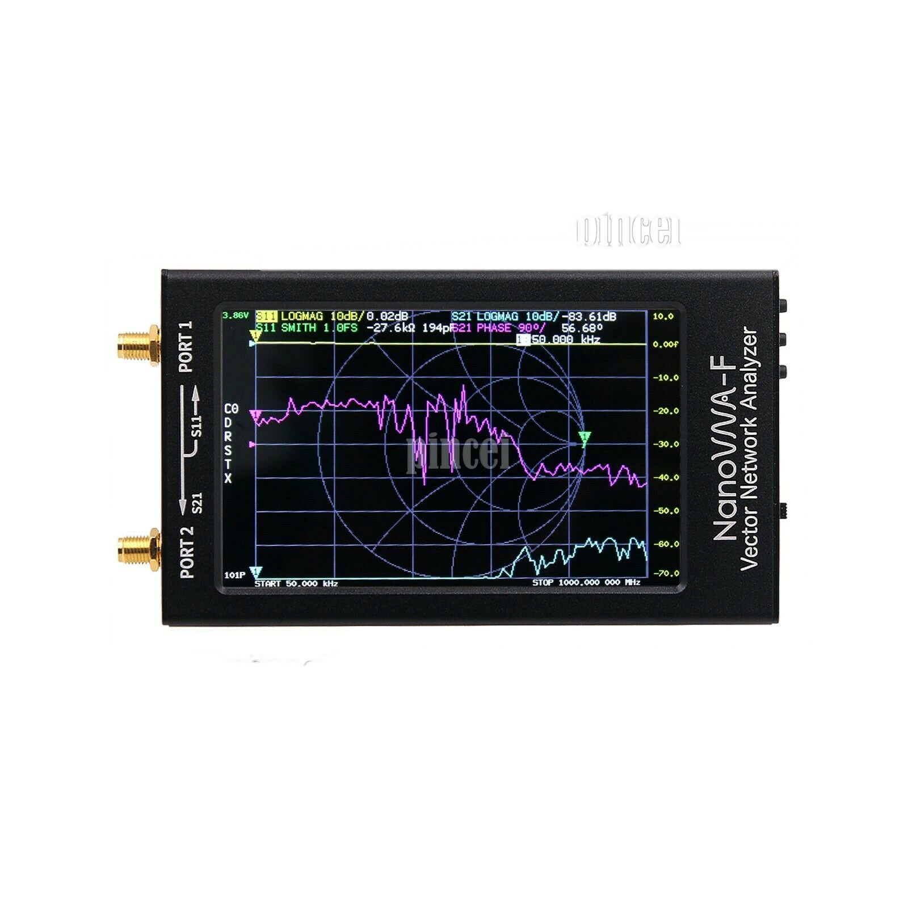
Meet the NanoVNA-F
Made in China
by Deepelec
Design & Software
Leon Huang BH5HNU
50kHz-1.3 GHz
Vector Network
Analyzer
Latest Version 3.1 with 3 buttons.
~$100 !!!
Ereference
Ereflect
Ethru
3.8 in
Color Touch Screen Solid Aluminum Case

Slide 4
What can You do with a VNA?
Measure your antenna’s impedance and plot it on a Smith chart vs frequency or just plot antenna’s SWR vs frequency.
Measure that unknown inductor in your junk box at your application frequency.
Measure the input and output impedances, gain or insertion loss and transmission phase of an amplifier or filter and plot all vs frequency.
This VNA covers 0.05-1300 MHz with and can store up to 5 sets of calibration data.
All this for about $100 and it is almost as capable as a modern $30K Keysight (HP) VNA. This is NOT your old MFJ 259!!!

Slide 5
What’s in a number? What does the VNA measure
Ordinary numbers are scalar, not vector.
6 is a scalar number. So is 376.730313.
A scalar number is given by it’s magnitude only.
SWR is scalar. So is Gain in dB. Both have only a magnitude.
A vector is a complex number such as 3 + j7. Impedance is a vector quantity. Like Z = 47 – j17 ohms. A vector has both magnitude and direction.
The NanoVNA-F measures vector quantites but provides both vector and scalar results.

Slide 6
A Vector has a Magnitude and Angle and Real and Imaginary Parts
Many things in electronics are best represented with complex numbers.
Impedance is a complex quantity. For example: The impedance of a certain 33 ohm wire wound resistor is 33 +j26 ohms at 10 MHz.
33 ohms is the Real part or Resistance.
26 ohms is the Imaginary part or Inductive Reactance a positive number. Capacitive Reactance is a negative quantity like –14 ohms.
“j” is the way EE’s write a complex number. ( j replaces i from high school.)

Slide 7
Another Way to Express Complex Quantities is in Polar Form
Polar quantities are given by a Magnitude and an Angle. This is very useful for plotting polar impedance data and for for plotting reflection coefficient measurements on the Smith Chart.
For Z = 33 + j26 ohms the Magnitude of Z = sqrt(R^2 + X^2) = sqrt(33^2+26^2) = 42.01 ohms.
The Angle of Z = tan-1(X/R) = tan-1(26/33) = 38.23 deg.
To convert Magnitude and Angle back to Real and Imaginary parts: Real = Magnitude*cos(Angle), Imaginary = Magnitude*sin(Angle)

Slide 8
Vector and Scalar Numbers
Imaginary Axis
A scalar has Magnitude
but not Direction
Vector
A vector has both
Magnitude and
Direction
Imaginary
Part
Magnitude
3.14159
Angle
Real Axis
Real Part
A Scalar Quantity
A Vector Quantity
Fortunately all the math is done inside the NanoVNA, so you don’t have to do it!

Slide 9
The First word in VNA is Vector.
Our 33 ohm wire wound resistor is not a pure resistance. Its impedance is 33 + j26 ohm at 10 MHz which looks like a 33 ohm resistor in series with a +26 ohm inductive reactance.
So the impedance of the resistor is a complex number or a Vector quantity. The VNA-F measures vector quantities.
The inductive reactance comes from the turns of resistive wire making up the 33 ohm wire wound resistor.

Slide 10
The Second word in VNA is Network
Networks are black boxes with ports. A One Port has a pair of terminals that allows connection to the outside world. A port can be a pair of screw terminals or a coax connector such as an SO-239.
Our 33 +j26 ohm impedance is a One Port. It has a single pair of terminals.
An amplifier that has a single input and a single output is a Two Port. It has a two pairs of terminals.
Today we will mostly deal with One Port and Two Port networks.

Slide 11
The Last word in VNA is Analyzer
A Vector Network Analyzer is an instrument that can accurately measure the characteristics of 1, 2 or N port networks and express the results in many forms both Vector and Scalar.
It can characterize One Ports such as antennas and loads and Two Ports such as filters and amplifiers.
It can present results in terms of complex Impedance, polar Gain and Phase, or scalar SWR, Return Loss and more.

Slide 12
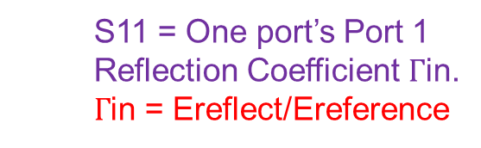


The One Port: How is it characterized?
Forward Wave
S11 = One port’s Port 1
Reflection Coefficient $Γ$in.
$Γ$in = Ereflect/Ereference
Z=50+j0
Ereference
$S$11
Transmission Line
Zo=50 ohms
$Γ$in =
V(F)
Port 1
One Port
50 ohm Generator
Ereflect
S11 Reference Plane
Reflected Wave

Slide 13
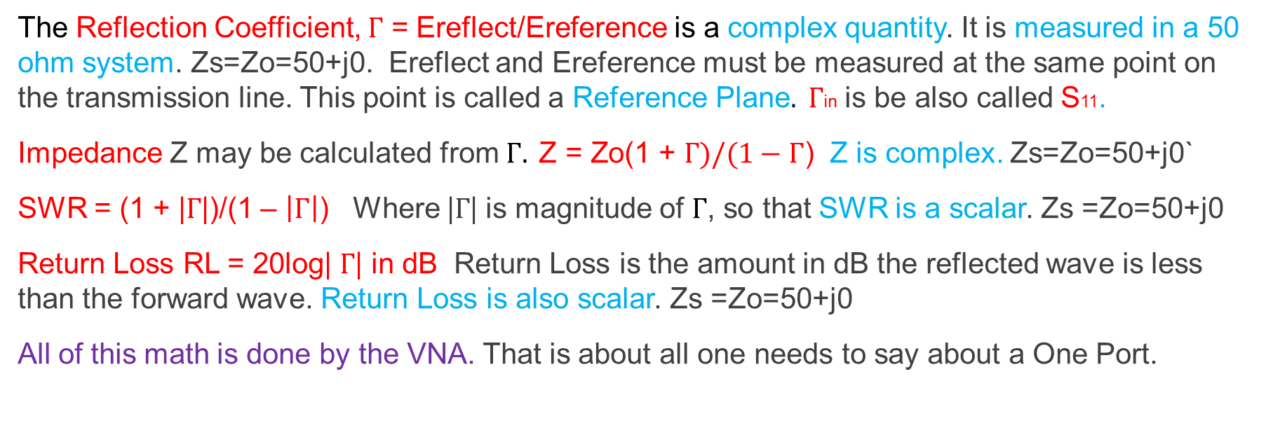
Forward and Reflected Waves
The Reflection Coefficient, $Γ$ = Ereflect/Ereference is a complex quantity. It is measured in a 50 ohm system. Zs=Zo=50+j0. Ereflect and Ereference must be measured at the same point on the transmission line. This point is called a Reference Plane$. Γ$in is be also called S11.
Impedance Z may be calculated from $Γ. \text{Z}\text{ = }\text{Zo}\text{(1 + }Γ)/(1−Γ\text{)}$ Z is complex. Zs=Zo=50+j0`
SWR = (1 + |$Γ$|)/(1 – $\left|Γ\right|$) Where |$Γ$| is magnitude of $Γ$, so that SWR is a scalar. Zs =Zo=50+j0
Return Loss RL = 20log| $Γ$| in dB Return Loss is the amount in dB the reflected wave is less than the forward wave. Return Loss is also scalar. Zs =Zo=50+j0
All of this math is done by the VNA. That is about all one needs to say about a One Port.

Slide 14


The Two Port is a little more complex
Input Forward Wave
Output Reflected Wave
Reference Planes
Zs=50+j0
Port 1 Port 2
Ereference1
Ereflect2
S21
Transmission Line
Zo=50 ohms
Transmission Line
Zo=50 ohms
Zl=
50+j0
V(F)
$S$11
Two Port
$S$22
S12
50 ohm Generator
Ereflect1
Ereference2
50 ohm Load
This model is used if
you have a VNA that
measures forward and
reverse S parameters.
Input Reflected Wave
Output Forward Wave

Slide 15

The Two Port As Seen By The NanoVNA-F
Input Forward Wave
Port 1 Port 2
Output Transmitted Wave
Zs=50+j0
Ereference
Ethru
S21
$S$11
Transmission Line
Zo=50 ohms
Transmission Line
Zo=50 ohms
Zl=
50+j0
V(F)
Two Port
50 ohm Generator
Ereflect
50 ohm Load
To measure port 2 reflection coefficient or reverse transmission, the two port must be reversed. That is not
too much to ask for a $29.9K savings over a $30K VNA.
Input Reflected Wave

Slide 16
The Two Port
The VNA-F measures all of the same quantities at Port 1 of the Two Port that we have discussed in the previous One Port case.
In addition the VNA can measure Gain or Loss from Port 1 to Port 2 of the two port along with associated Transmission Phase data. Both can be plotted vs frequency.
By reversing the Two Port, its reverse Gain/Loss and Phase may be measured along with Port 2’s Impedance, SWR or Return Loss.

Slide 17
Two Port Transmission Characteristics
Gain and Phase of the Two Port are obtained from Ethru/Ereference. This is complex voltage gain. Ethru and Ereference are measured in a 50 ohm system where Zs = Zl = Zo = 50+i0 ohms. Complex voltage gain is also called S21.
Power Gain = 10*log|Ethru/Ereference| in dB a scalar that expresses Pout./Pin
Voltage Gain = 20*log |Ethru/Ereference| in dB a scalar that expresses Vout/Vin.
Phase is the angle of Ethru/Ereference or tan-1(Ethru/Ereference) It is also scalar.
Gain and Phase taken together, S21 is a polar vector quantity characterizing transmission thru the two port device. Zs = Zl = Zo = 50+i0 ohms. S21 is usually expressed as a Power Gain Log Magnitude in dB and an Angle in degrees. As before all math is done in the VNA

Slide 18
Reference Planes for 1 and 2 Port Networks
Ereference
Ethru
Zs=50+j0
Transmission Line
Zo=50 ohms
V(F)
Transmission Line
Zo=50 ohms
Zl=
50+j0
Two Port
50 ohm Generator
Ereflect
Reference Planes
Port 1
Connect DUT & cal stds here
Port 2
To accurately measure the phase thru a device or the phase of a port reflection coefficient, the input and output
reference planes must be specified and the VNA must be calibrated at the same reference planes. Otherwise
the input impedance and transmission phase will change as the cal reference plane moves away from the DUT
reference planes. Keep the transmission line lengths the same when measuring the cal standards and the DUT!

Slide 19
Sometimes the reference planes are at connector
interfaces, sometimes they are not.
Coaxial device, a bandpass filter
Microstrip SMD transistor test fixture
Printed Circuit
Board Test Fixture
Transistor
Microstrip
Transmission
Lines
Reference
planes
Gnd
Bandpass
Filter
100-150 MHz
Reference
planes
Gnd
Female SMA
coaxial connectors
Reference Planes
Must cal here!
Here the reference planes are at the SMA
interfaces. You need female sex cal stds.
Make them with female SMA connectors!
Here you will need 4 extra fixtures with the transistor
replaced by shorts, opens, 50 ohm R’s and a thru.
This is how transistor S parameters are measured.

Slide 20
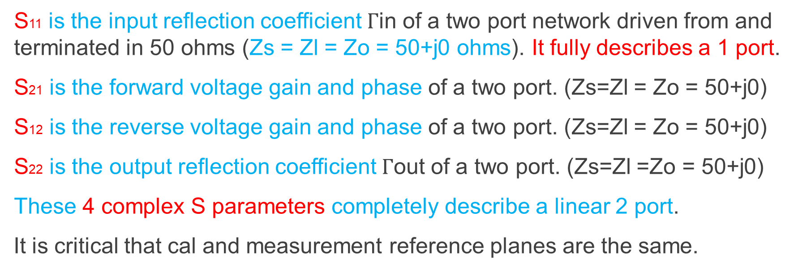
Measuring S Parameters of a Two Port network
S11 is the input reflection coefficient $Γ$in of a two port network driven from and terminated in 50 ohms (Zs = Zl = Zo = 50+j0 ohms). It fully describes a 1 port.
S21 is the forward voltage gain and phase of a two port. (Zs=Zl = Zo = 50+j0)
S12 is the reverse voltage gain and phase of a two port. (Zs=Zl = Zo = 50+j0)
S22 is the output reflection coefficient $Γ$out of a two port. (Zs=Zl =Zo = 50+j0)
These 4 complex S parameters completely describe a linear 2 port.
It is critical that cal and measurement reference planes are the same.

Slide 21
So what can an under $100 VNA do for me?
Measure all of the scalar and complex quantities that we have discussed. Reflection Coefficient, Impedance, SWR, Return Loss, Gain, Loss, Transmission Phase and S parameters and more across 50kHz-1300 MHz.
Plot the data on a 4.3 inch color LCD screen or on your PC.
Perform conversions between measured data such as converting a complex reflection coefficient to complex impedance (Z=R+jX).
Do all of these things with darn good accuracy.

Slide 22
So we now know what the VNA-F can measure
What about:
VNA-F specifications.
What is in the VNA-F?
How does the VNA-F work?
How to use the instrument.

Slide 23
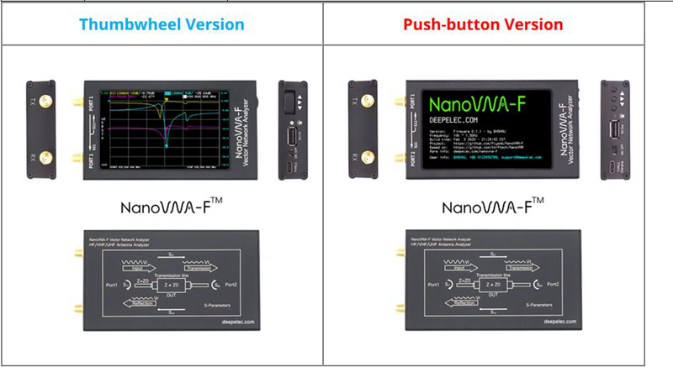
Which NanoVNA-F Should I Get?
Older V2.3 has a rotary dial
Newer V3.1 with Release 0.1.5 Firmware
3 Buttons
Dial has been less reliable than buttons
This is the one I recommend

Slide 24
VNA-F Key Specifications
Frequency range 50kHz-1300 MHz Useable to 1500 MHz
Frequency stability +/-2.5 ppm Frequency Synthesizer
Data points/sweep 101 10X more running VNA from your PC
Number of traces 4 All types, both reflection & transmission
Number freq markers 4 You can use up to 4 frequency markers
Number stored cals 5 Five different frequency ranges
Formats: Log Mag, Linear Mag, Phase, Polar, Smith Chart, SWR, Z, R, X
Battery capacity 5000mAh The battery lasts well over 8 hours
Display 4.3” Diagonal 800 X 480 Pixels
Dynamic Range Reflection Transmission
50kHz-300MHz 60 dB 70 dB Max power into
300MHz-600MHz 50 dB 70 dB VNA RX, TX ports
600MHz-1.0GHz 40 dB 60 dB +20 dBm = 100 mW
40 dB reflection DR yields a reflection coefficient floor of 0.01 or a SWR floor of 1.02

Slide 25
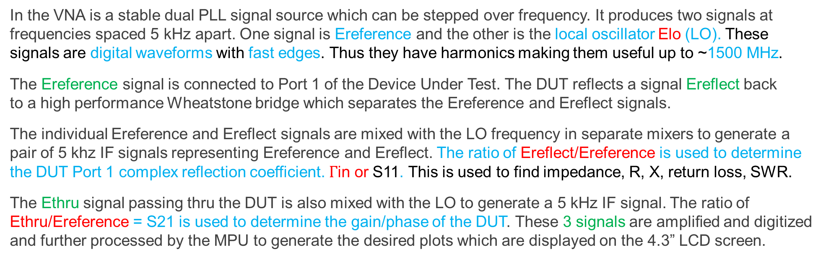
How does this very clever instrument work?
In the VNA is a stable dual PLL signal source which can be stepped over frequency. It produces two signals at frequencies spaced 5 kHz apart. One signal is Ereference and the other is the local oscillator Elo (LO). These signals are digital waveforms with fast edges. Thus they have harmonics making them useful up to ~1500 MHz.
The Ereference signal is connected to Port 1 of the Device Under Test. The DUT reflects a signal Ereflect back to a high performance Wheatstone bridge which separates the Ereference and Ereflect signals.
The individual Ereference and Ereflect signals are mixed with the LO frequency in separate mixers to generate a pair of 5 khz IF signals representing Ereference and Ereflect. The ratio of Ereflect/Ereference is used to determine the DUT Port 1 complex reflection coefficient. $Γ$in or S11. This is used to find impedance, R, X, return loss, SWR.
The Ethru signal passing thru the DUT is also mixed with the LO to generate a 5 kHz IF signal. The ratio of Ethru/Ereference = S21 is used to determine the gain/phase of the DUT. These 3 signals are amplified and digitized and further processed by the MPU to generate the desired plots which are displayed on the 4.3” LCD screen.

Slide 26
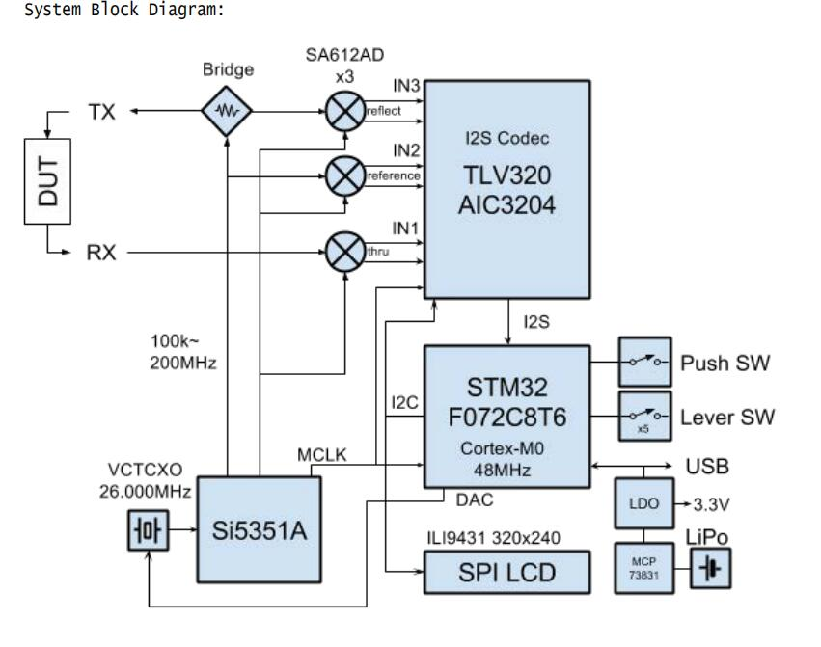
NanoVNA-F System Block Diagram
The VNA port marked TX delivers a signal to Port 1 of
the DUT which reflects some of the incident signal
back at VNA TX port at a certain phase. The Bridge
separates Ereference and Ereflect and directs these
signals to its correct mixer.
The portion of the signal passing through the
DUT and exiting its Port 2 is delivered via the VNA
RX input and thus to the thru mixer. Gain/Phase are
Determined from the ratio of Ethru/Ereference.
The Si5351A is a multi output PLL. Its two output
frequencies are spaced 5 kHz, the system IF freq.
The output of each SA612AD mixer is at the 5 kHz
IF freq. The TLV320 Codec serves as an IF amplifier
and ADC that digitizes each of the three channels.
The SMT32F07 MPU processes the 3 digitized data
paths and displays results on the 4.3” LCD display.
Port 1
Port 2

Slide 27
What’s inside the NanoVNA-F?

Slide 28
Here is the other side of its PCB

Slide 29
Using the NanoVNA-F
Start a measurement:
1. Set the frequency range (STIMULUS→START/STOP or CENTER/SPAN)
2. Calibration (According to actual needs, refer to the next chapter)
3. Select display format and channel (DISPLAY→FORMAT/CHANNEL)
4. Save the parameters for the next measurement.(SAVE→0/1/2/3/4
or CW FREQUENCY.)
)
)

Slide 30
VNA-F touchscreen showing main screen menu functions
Change format, color, scale, or turn on/off traces
Display, activate or change marker functions
Set start & stop or center & span frequencies
Reset & measure calibration standards
Recall measurement parameters from one of
the VNA’s 5 registers.
Set language, cal screen & see VNA-F version
End touch screen input

Slide 31
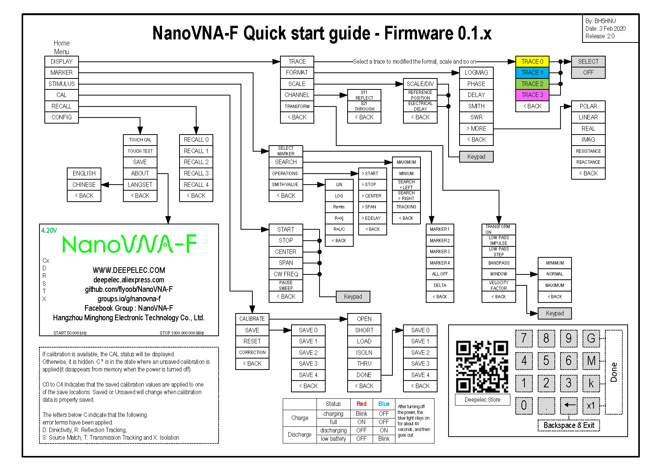
NanoVNA Menu Structure

Slide 32
Calibration
The internal hardware of the VNA is NOT perfect leading to poor accuracy if it is not calibrated.
By measuring several accurately known standards, the VNA may be corrected to yield very accurate measurements.
The standards used are a coaxial short, open, two precision 50 ohm loads and a through connection. The calibration done with these standards is known as a SOLT calibration (short/open/load/through).

Slide 33
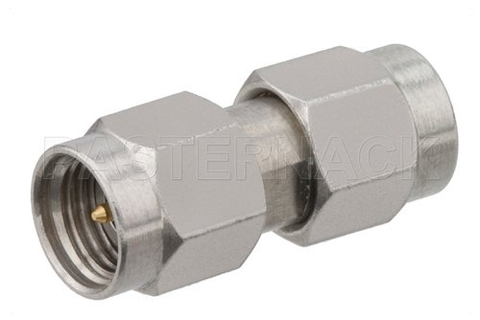
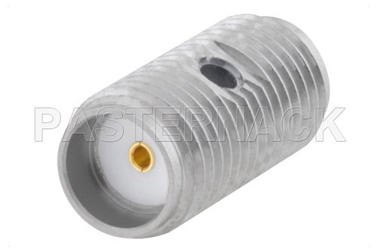
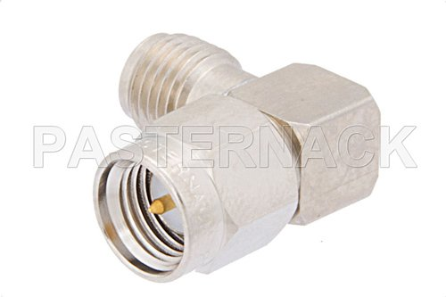
SMA Calibration Standards
Double Double Right
Male Female Angle

Slide 34
Brief summary of the Calibration Steps
1) Open CAL menu and press RESET
2) Open CALIBRATE menu
3) Connect SMA Open to PORT1 wait more than 3 seconds(wait for the screen to stabilize)and press OPEN
4) Connect SMA Short to PORT1 wait more than 3 seconds(wait for the screen to stabilize) and press SHORT
5) Connect SMA Load to PORT1 wait more than 3 seconds(wait for the screen to stabilize) and press LOAD
6) Connect SMA Load to PORT1, connect second Load to PORT2, wait more than 3 seconds(wait for the screen to stabilize) and press ISOLN
Note: if you don't have second Load, just leave PORT2 open.
7) Connect RF cable from PORT1 to PORT2 wait more than 3 seconds(wait for the screen to stabilize)and press THRU
8) Press DONE, save to 0/1/2/3/4 one of them.

Slide 35
OK OK! Enough of the theory.
Let’s measure something!

Slide 36
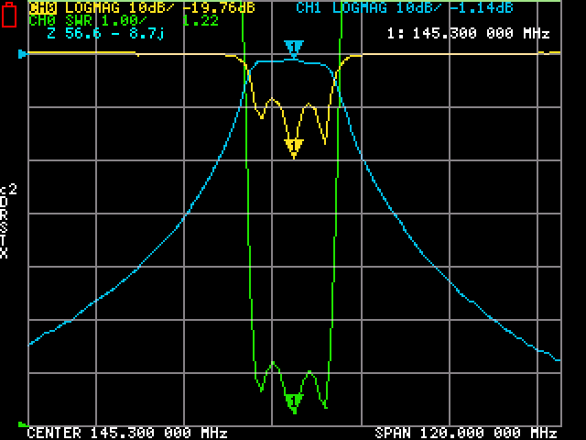
A two meter Bandpass Filter
Fcenter = 145.3 MHz, 20 MHz/div
The blue trace is transmission thru the
filter at 10 dB/div. The marker shows
the filter’s loss = 1.14dB at 145.3 MHz.
The green trace shows the filter’s input
SWR. SWR at the marker is 1.22
The yellow trace shows the filter’s input
Return Loss corresponding with its SWR.
Return Loss at the marker is 19.76 dB
All of these measurements are scalar. No
phase information is displayed. We are
Using Cal File 2, a SOLT calibration.

Slide 37
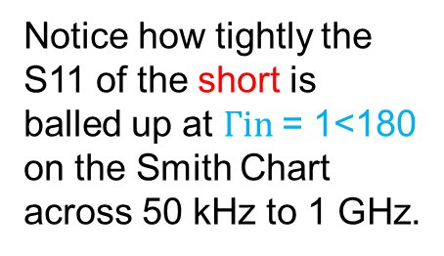
VNA Displaying a Short on a Smith Chart 50kHz-1GHz
Notice how tightly the
S11 of the short is
balled up at $Γin$= 1<180
on the Smith Chart
across 50 kHz to 1 GHz.

Slide 38
VNA Measuring a Cable 50kHz-1GHz
Blue trace is cable loss in dB
Yellow trace is input Return
Loss in dB
Green Trace is Smith Chart
Plot of input impedance Zin
VNA Displaying Short on Smith Chart 50kHz-1GHz

Slide 39
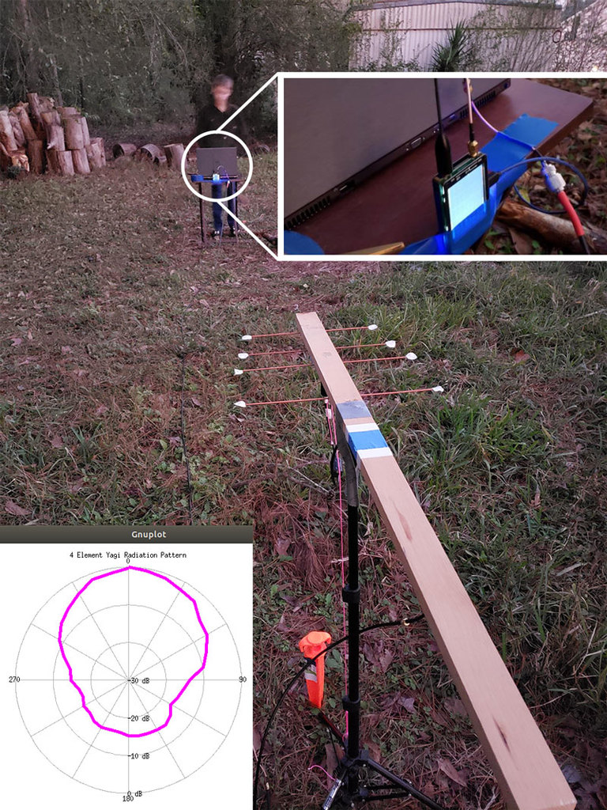
Measuring the
Polar Pattern of a
UHF Yagi
Yagi connected to TX port of VNA.
An omni whip antenna connected to
RX port. The VNA is set to a single
cw frequency.
The UHF Yagi is rotated to capture the plot.
A PC connected to the VNA generates
the polar patern plot as the Yagi is
rotated.

Slide 40
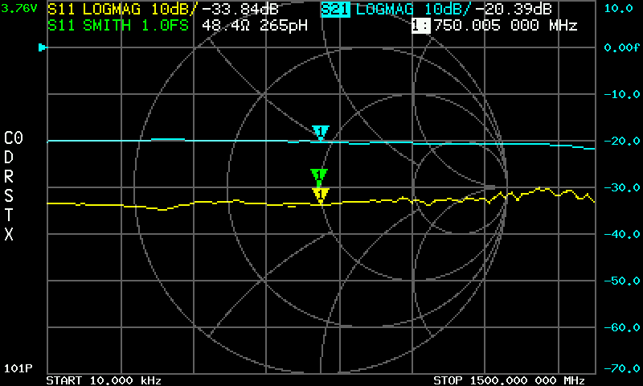
Attenuation and Input Return Loss of a 20 dB Pad 10-1500 MHz
Blue Trace Attenuation = 20.39 dB
Green Trace S11 on Smith Chart
Bunched up at 50+j0 ohms
Yellow Trace Input Return Loss
33.84 dB
Marker at 750.005 MHz

Slide 41
NanoVNA Saver Software
Transfers measured data from the NanoVNA to your PC or Mac or Linux box.
Allows up to 10 segments of the measured data to be plotted (1010 points) for better resolution.
Free Shareware available at Github.com!
Display up to 4 different plots as once. For example Smith chart, log mag S11, phase and real/imag Z
Permits data averaging and controls the VNA from your PC, Mac or Linux box.
Permits a customized data frequency range to be generated from a wider band calibration.
And MUCH, MUCH more.
Did I mention it was free?

Slide 42
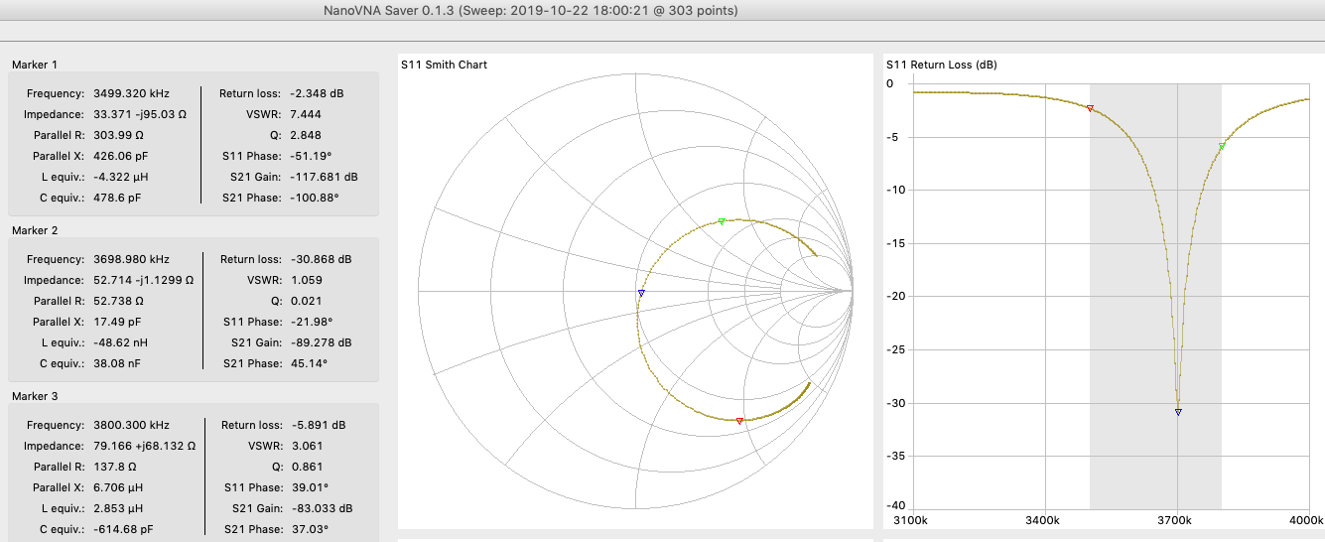
80 Meter Windom OCF Dipole S11 on VNA Saver

Slide 43
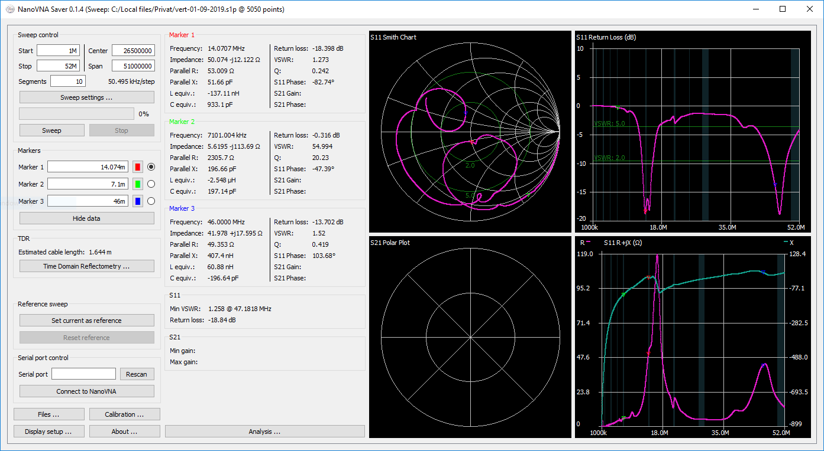
VNA Saver Software Display of a One Port Circuit with Two Resonances

Slide 44
Conclusion
The NanoVNA-F is a very useful tool for many of your RF measurement
needs. It’s far more versatile and accurate than most one port antenna analyzers and many other nanoVNAs. It is way less expensive too!
With its 4.3” touch screen, multiple measurement types, solid aluminum case, ease of use, many supplied accessories, and low cost the instrument is a joy to use and you may well want one in your shack.
Beware of nanoVNA’s in the ~$50 price range. They have 2.8” LCD screens, no aluminum case and are not as well made as the VNA-F.

Slide 45
Questions?

